Slide 1
Diy project

Slide 2
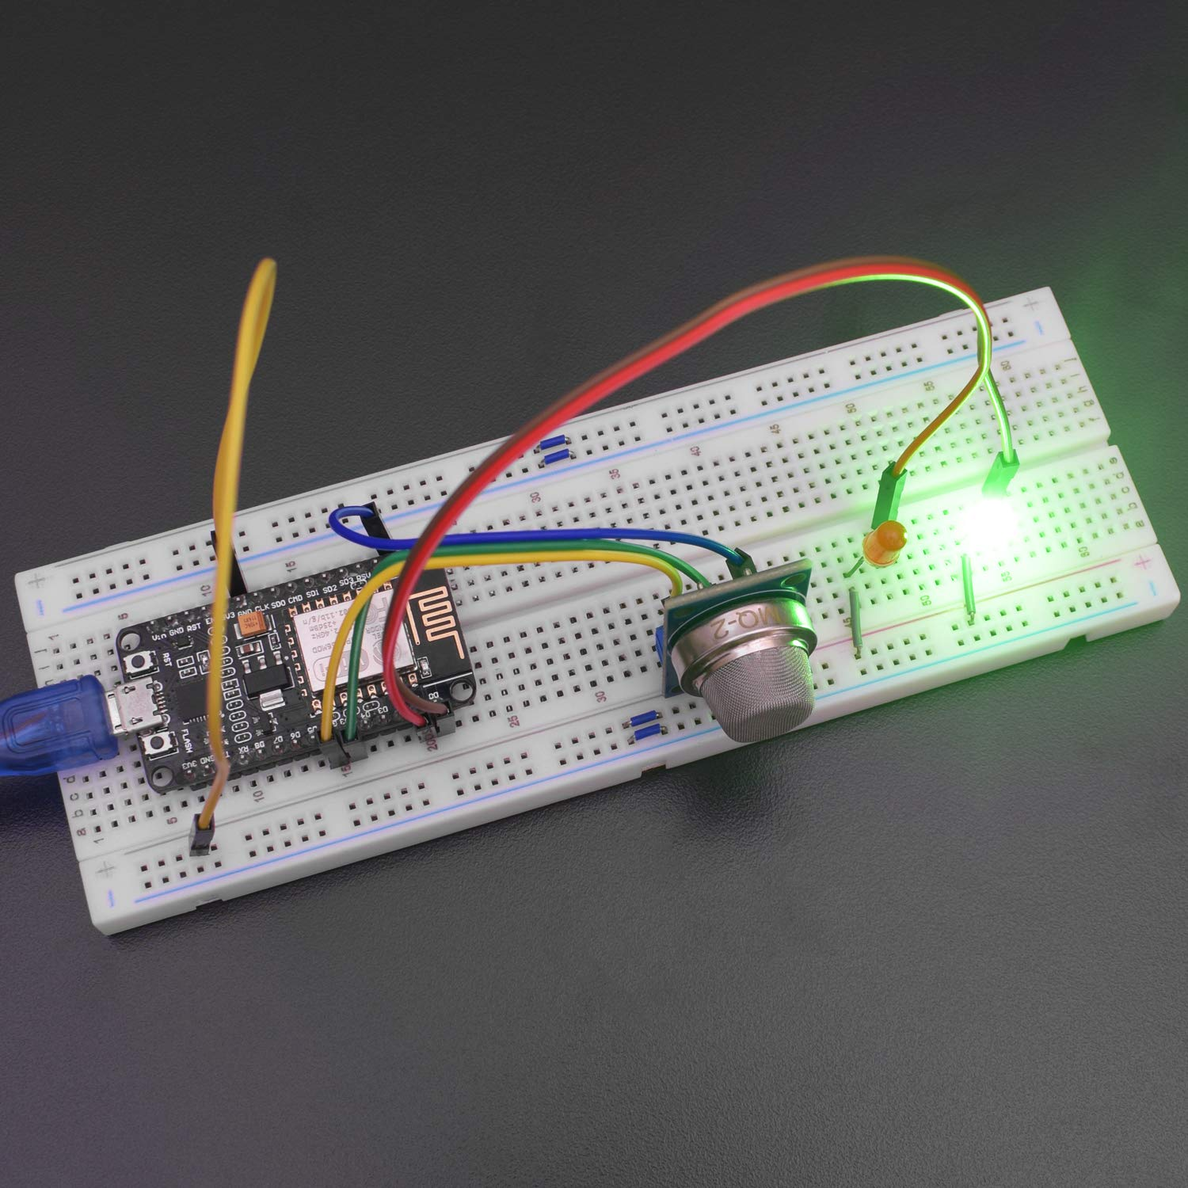
Iot based lpg gas leakage detection system

Slide 3
Krithi bethu 23cs10010 parv makwana 23cs10050 raman Dubey 23ch30026 kaustav Mishra 23cs10030
Team members

Slide 4
Problem statement: In homes, gas leaks from appliances such as stoves, water heaters, or furnaces can lead to asphyxiation or fire outbreaks. Industrial settings face similar dangers, with the added risk of catastrophic accidents due to the presence of highly flammable or toxic gases. Examples of industrial accidents like the Bhopal disaster in 1984, where a gas leak resulted in thousands of fatalities, highlight the urgent need for effective gas detection systems. Symptoms of gas exposure, as stated above, underscore the importance of early detection and mitigation.
problem solving: Implementing a gas detection project using an ESP8266 mcu, and an MQ5 gas sensor can help address these risks by providing early warning systems and remote monitoring capabilities, thereby enhancing safety in both residential and industrial environments.

Slide 5
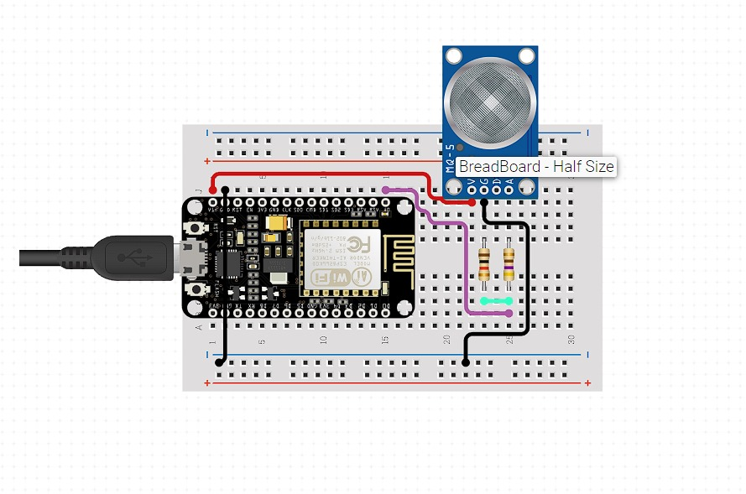
Curcuit diagram

Slide 6
List of components
Mq5 gas sensor
Nodemcu esp8266
Breadboard
Male to Male jumperwires
Resistor 1k ohm
Resistor 470 ohm

Slide 7
Working principle
Working principle of lpg gas detection system built by using nodemcu esp8266 and mq5 gas sensor ChatGPTThe LPG gas detection system built with NodeMCU ESP8266 and MQ5 gas sensor operates by measuring the concentration of LPG in the surrounding air. The MQ5 gas sensor detects the presence of LPG by its sensitivity to combustible gases.Here
The MQ5 sensor detects the presence of LPG gas molecules in the air and generates an analog voltage proportional to the concentration of LPG.
The NodeMCU ESP8266 reads this analog voltage through its analog-to-digital converter (ADC).
The ESP8266 then processes this data and compares it with a predefined threshold value to determine if the concentration of LPG exceeds a safe level.
If the concentration exceeds the threshold, the ESP8266 triggers an alarm or activates other safety measures, such as sending a notification to a mobile device or turning off a gas valve.

Slide 8
Work distribution
Programming-krithi bethu and kaustav mishra
Physical assembly of components- raman dubey and parv makwana

Slide 9
thank you

